Slide 1
Warehouse Inventory Recorder Database
Unit Title | B9CY100 Advanced Programming Techniques
Unit Code | B9CY100
Unit Lecturer | Paul Laird
Level | 9
Restriction on time/Length | 3 minutes
Group | E
Group Members | Fernando Rushen Parth Parmar Veerabhadraswamy.NG
Subject | CA-TWO
Submission Date | 22nd April 2022
Mode of submission | Online via Moodle

Slide 2
Warehouse inventory recorder database
Purpose:
Primary intent of the project is to study and understand how to solve the real-time issue by using programming skills and related libraries. In this project work, we have worked on the issue to decode the data management systems in the warehouse and the detailed information collection software is built to solve the problem. This is done by utilizing the python programming language with the graphic user interface.
Scope:
In the project work, we have built the graphical user interface which can load the dataset, store the dataset, update and remove the dataset. For the development of the user interface, we have utilized python programming tool Tkinter and for the database operation we have used the sqlite3 database.

Slide 3
Warehouse inventory recorder database
Problem Scenario:
The Wearhouse inventory is difficult to handle by most of the large production houses and many retail businesses for analyzing the available products. Also, sometimes the poor management of products in the Wearhouse inventory can lead to loss, due to delay in the company’s operations.
To solve this issue with the warehouses’ inventory management system, we have developed a database that contains all the information about the products and the available quantities.

Slide 4
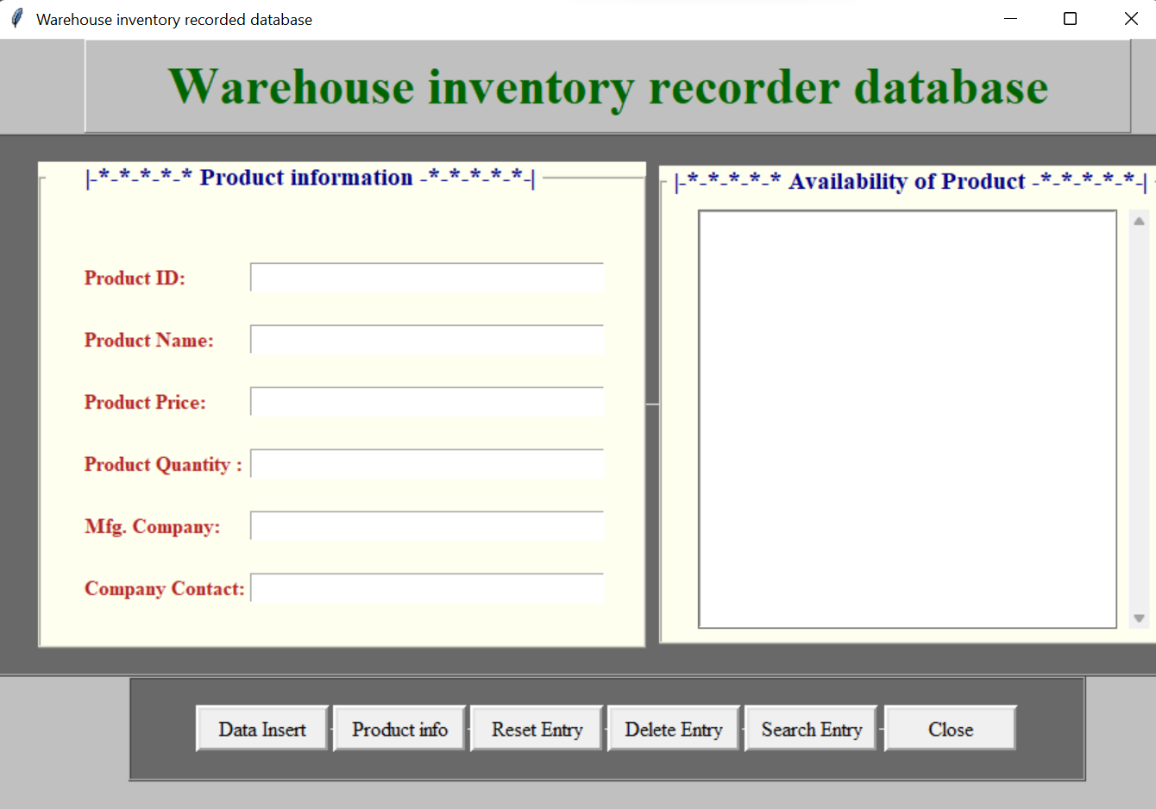
Warehouse inventory recorder database
Programming environment setups
The programming part is split into two main parts,
Front-end graphical user interface programming in python by using Tkinter.

Slide 5
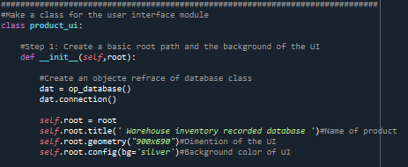
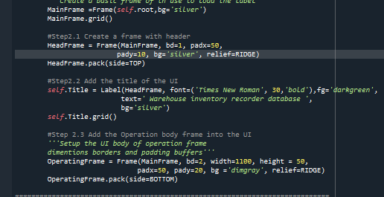
Warehouse inventory recorder database
2. The back-end operation is done by using the sqlite3 database.

Slide 6
Warehouse inventory recorder database
Thank you

